Slide 1
Project Report
Presence of Coronary Artery Disease (CAD)
Noel Sony

Slide 2
Project Overview
Coronary artery disease (CAD) limits blood flow in your coronary arteries, which deliver blood to your heart muscle. Cholesterol and other substances make up plaque that narrows your coronary arteries. CAD can lead to a heart attack, abnormal heart rhythms or heart failure.
Here we estimate the Presence of Coronary Artery Disease by taking various risk factors and running an ML model on it to classify presence of heart disease

Slide 3
Dependent and Independent Variables
Inputs
Age
Sex
Chest Pain type
Resting Blood Pressure
Serum Cholesterol
High Fasting Blood Sugar
Resting ECG results
Maximum Heart Rate Achieved
Exercise induced Angina
ST depression induced by exercise relative to rest
Slope of the peak exercise ST segment
Number of major vessels coloured by fluoroscopy
Outputs
Presence of Heart Disease

Slide 4
Sample Dataset
Age | Sex | Chest Pain Type | Resting Blood Pressure | Serum Cholesterol | High Fasting Blood Sugar | Resting ECG results | Max Heart Rate | Exercise induced Angina | ST depression ratio | Slope of peak ST segment | Number of major vessels coloured by fluoroscopy | Heart disease
49 | 0 | 3 | 160 | 180 | 0 | 0 | 156 | 0 | 1 | 2 | 3 | 1
37 | 1 | 2 | 130 | 283 | 0 | 1 | 98 | 0 | 0 | 1 | 1 | 0
48 | 0 | 4 | 138 | 214 | 0 | 0 | 108 | 1 | 1.5 | 2 | 2 | 1
54 | 1 | 3 | 150 | 155 | 0 | 0 | 122 | 0 | 0 | 2 | 0 | 0
39 | 1 | 3 | 120 | 339 | 0 | 0 | 170 | 0 | 0 | 1 | 1 | 0
45 | 0 | 2 | 130 | 237 | 0 | 0 | 170 | 0 | 0 | 1 | 0 | 0
54 | 1 | 2 | 110 | 208 | 0 | 0 | 142 | 0 | 0 | 2 | 0 | 0
37 | 1 | 4 | 140 | 207 | 1 | 0 | 130 | 1 | 1.5 | 2 | 1 | 1
48 | 0 | 2 | 120 | 284 | 0 | 0 | 120 | 0 | 0 | 1 | 2 | 0
37 | 0 | 3 | 130 | 211 | 0 | 0 | 142 | 0 | 0 | 2 | 0 | 0

Slide 5
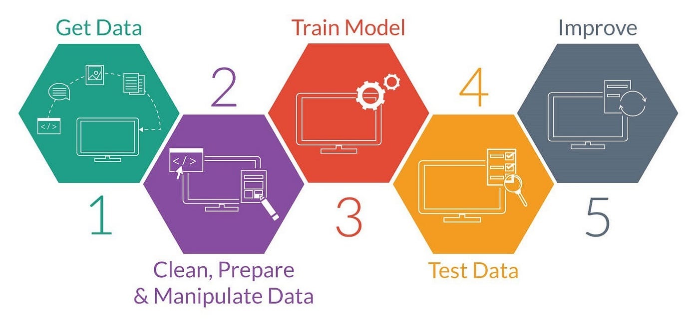
Project Block Diagram

Slide 6
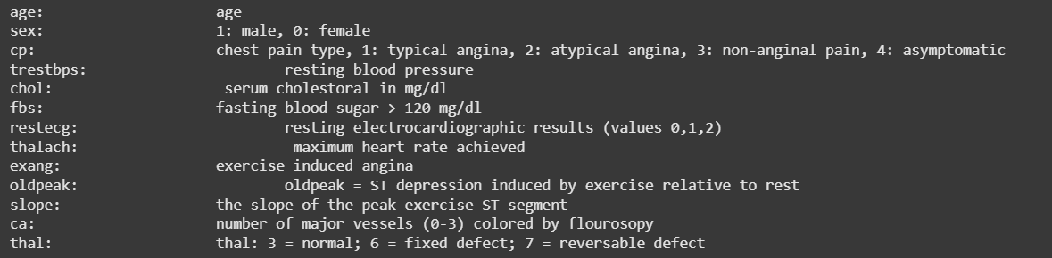
Input Variables Information
All input values are already encoded in dataset. Missing values are represented with ?
Target values represented by 0 for absence and (1,2,3,4) for presence to mark level of risk. We detect only presence and convert target to binary

Slide 7
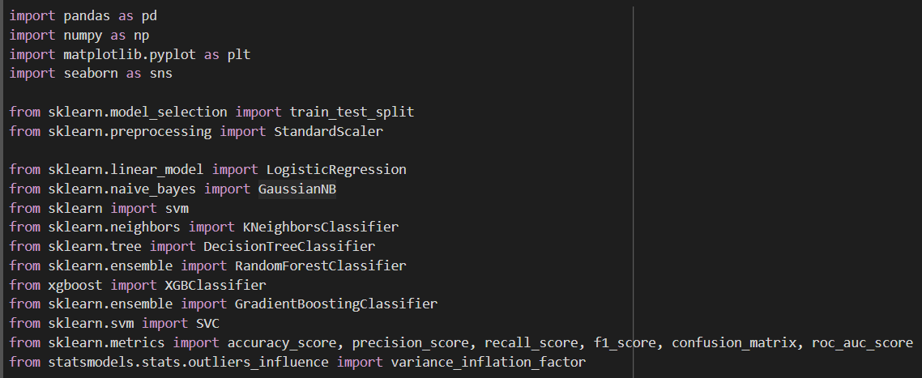
Import and read

Slide 8
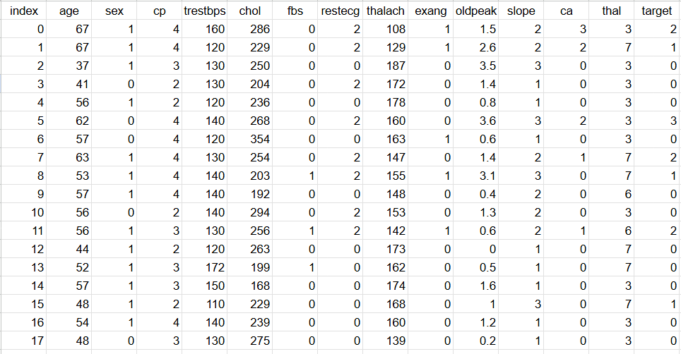
Dataset

Slide 9
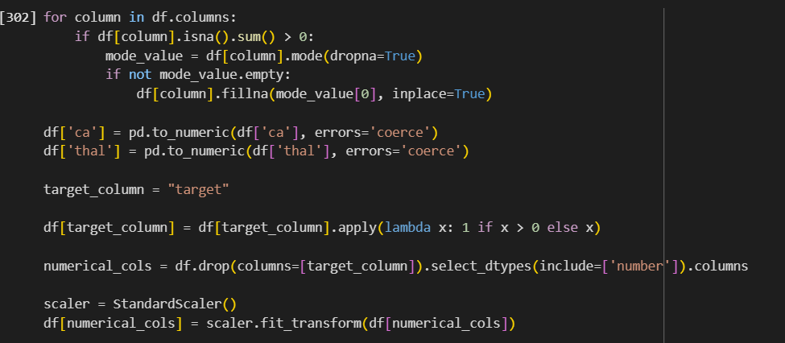
Drop Columns, Fill Missing Values, Scaling and convert target values to Binary

Slide 10
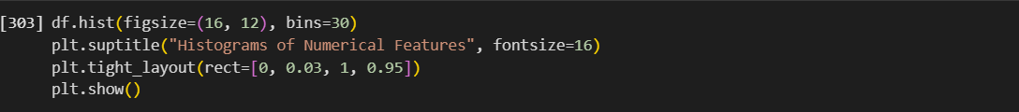
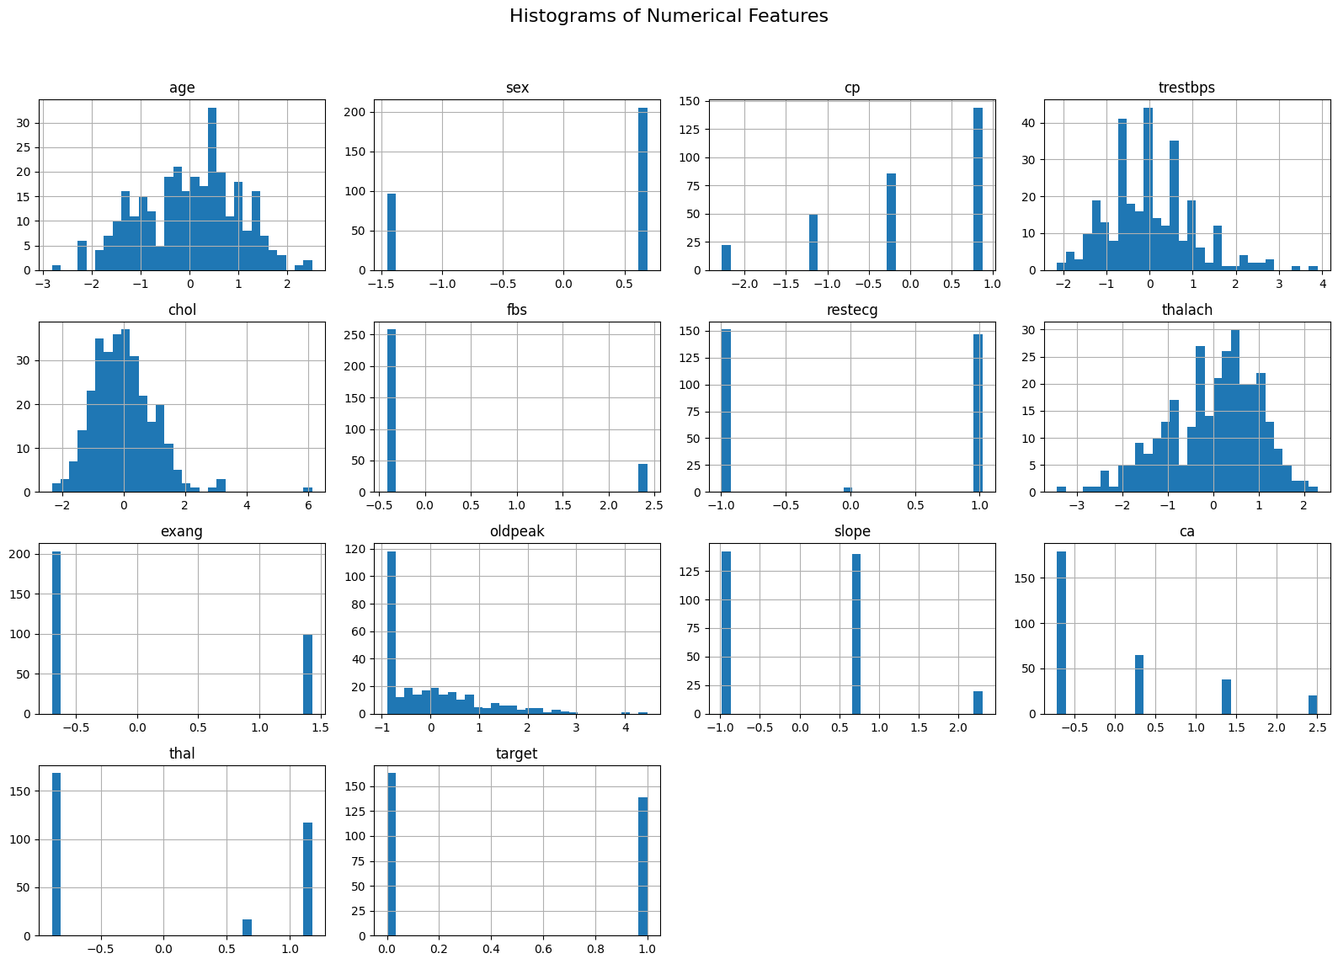
Histogram

Slide 11
Histogram (Remaining)

Slide 12
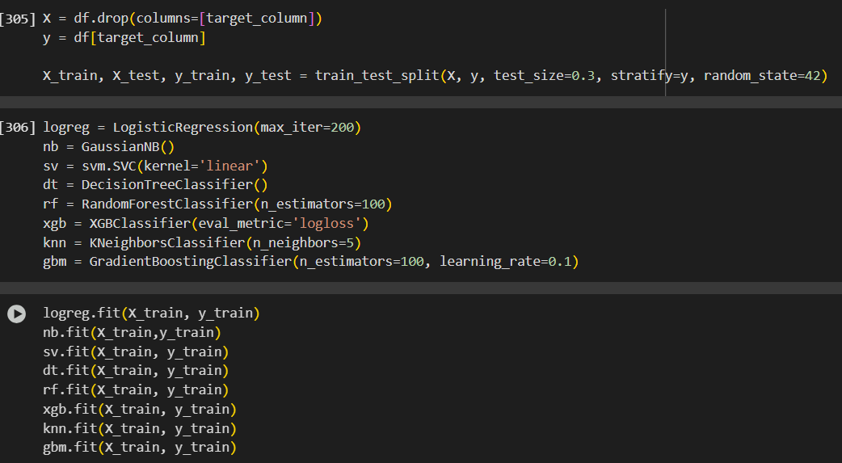
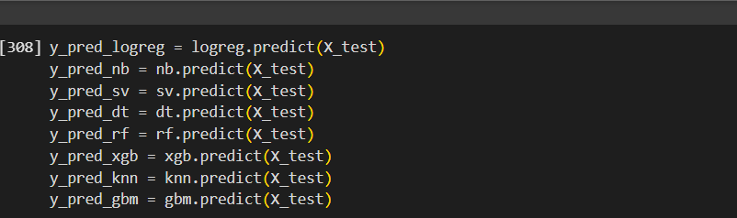
Splitting, Training and Testing of Model

Slide 13
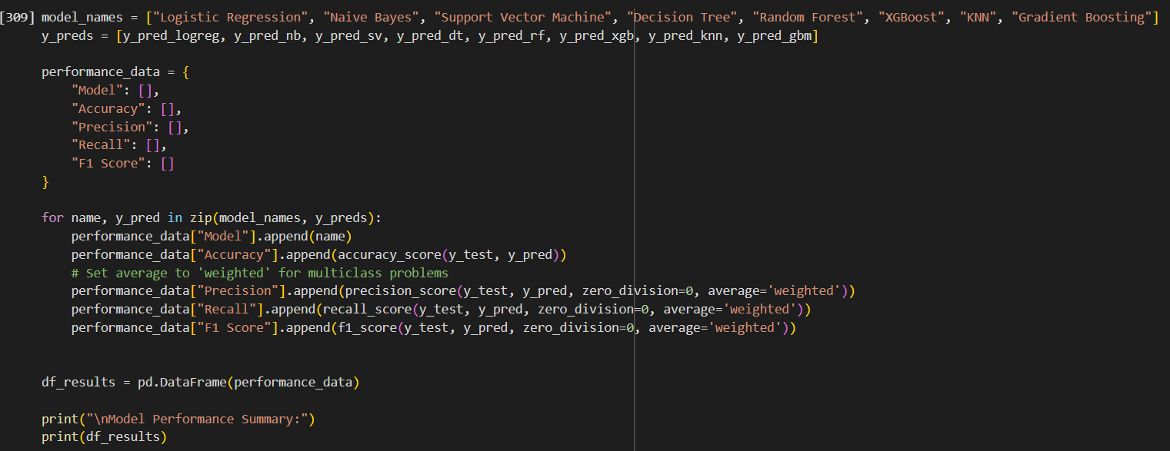
Accuracy, Precision, Recall and F1 score

Slide 14
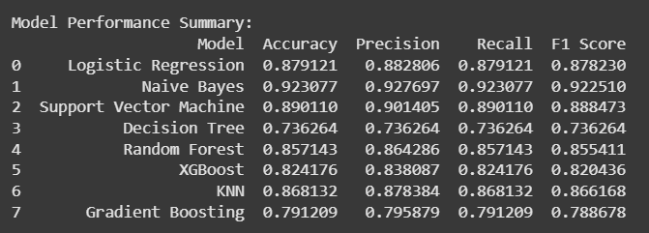
Model Performance Summary

Slide 15
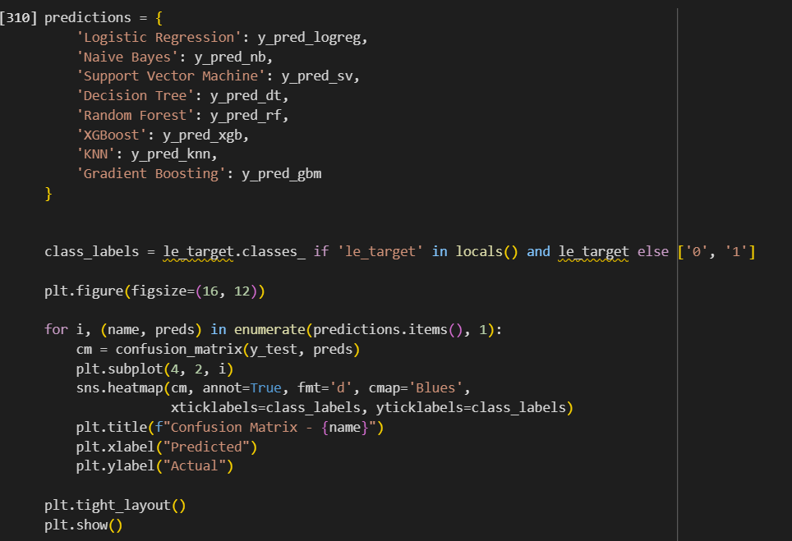
Confusion Matrix

Slide 16
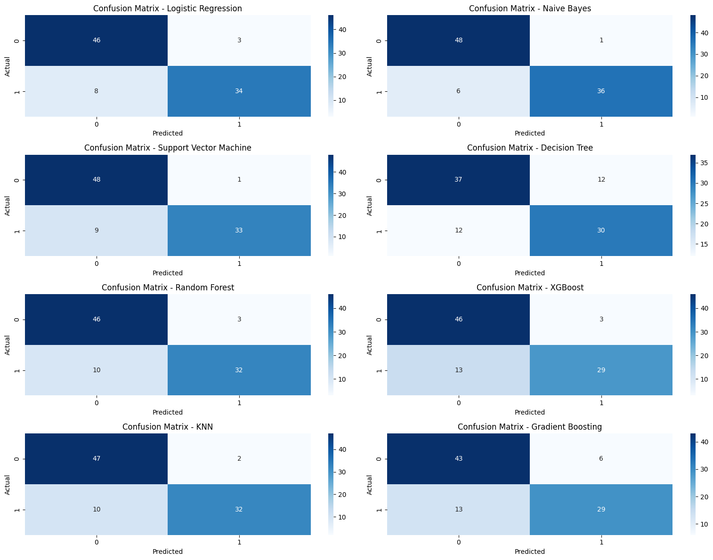

Slide 18
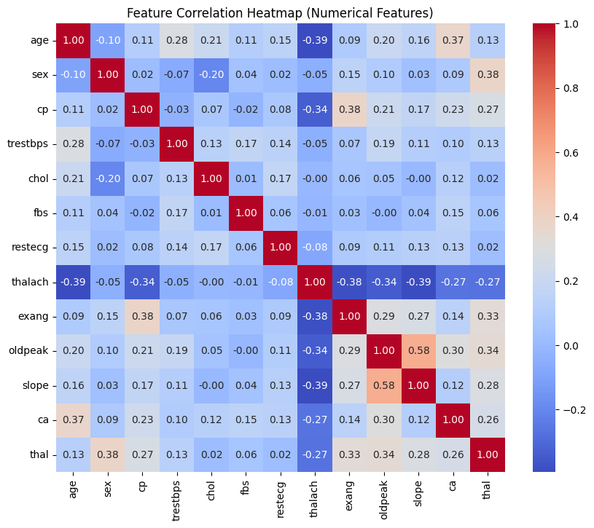
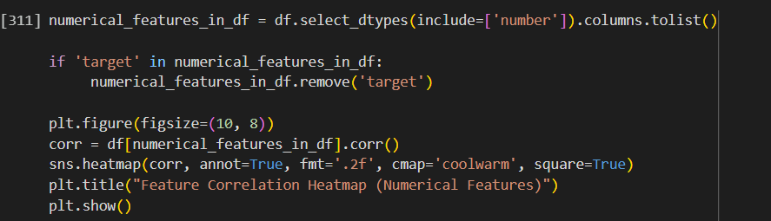
Correlation Heatmap

Slide 19
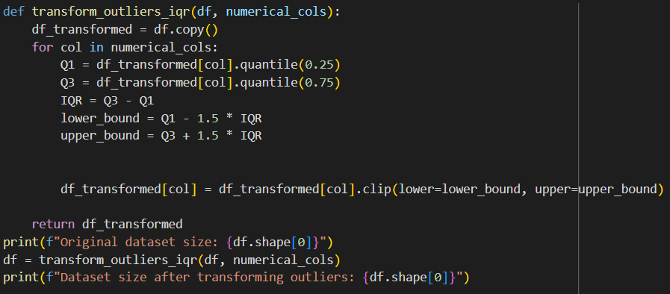
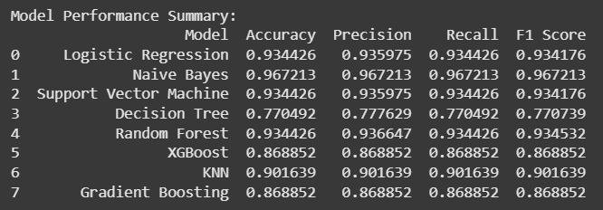
Performance after Removing Outliers
Before:
After:

Slide 20
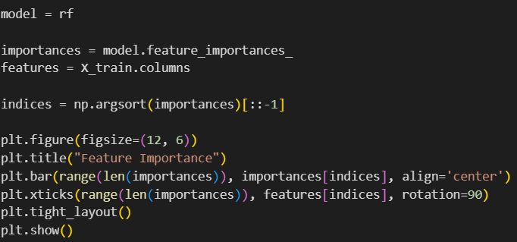
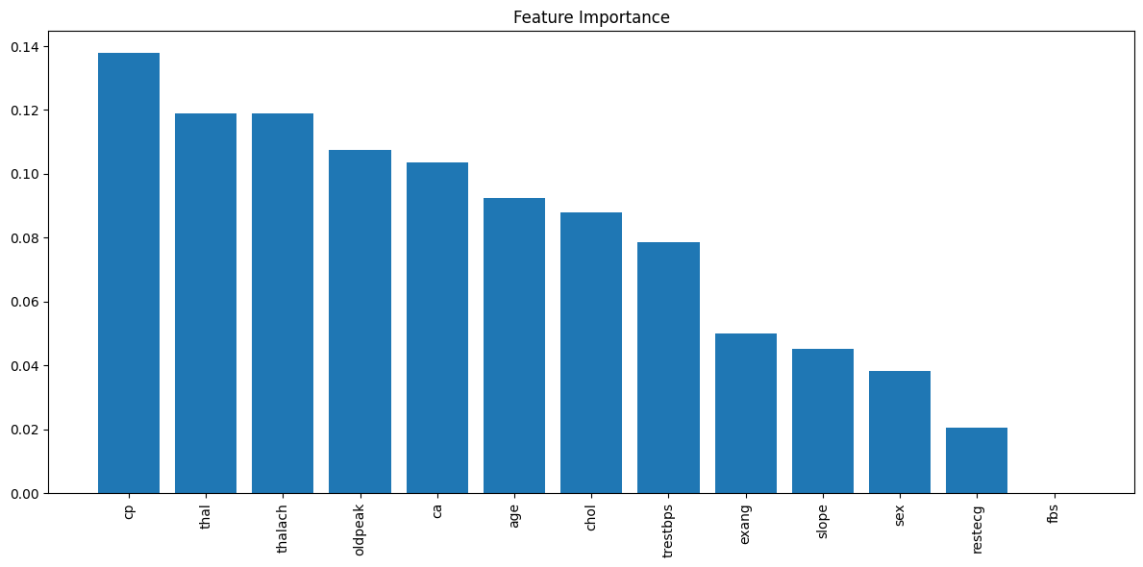
Feature Importance Graph

Slide 21
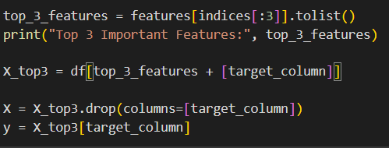
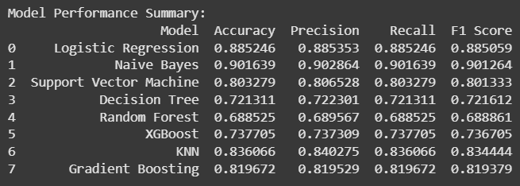
Comparing with 3 most Important Features
Before:
After:

Slide 22
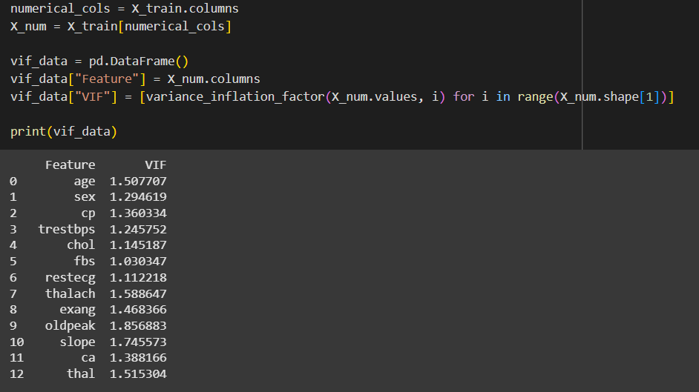
VIF

Slide 23
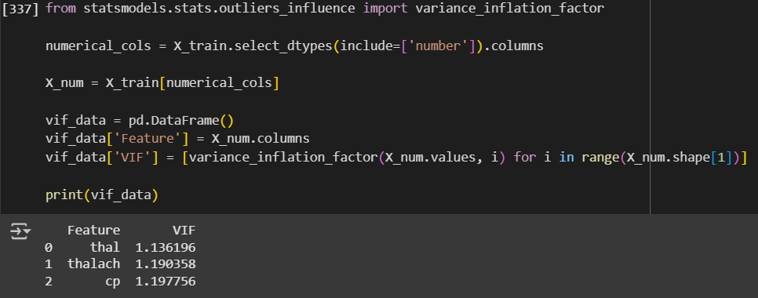
Top features by VIF

Slide 24
Thank You

